Slide 1


Slide 2


ML.NET
Phi Huynh

Slide 3
Agenda
What’s Machine Learning
ML.NET introduction
Demo

Slide 4
What’s machine learning?
Classical programming
Rules
Answers
Data
Machine Learning
Answers
Rules
Data

Slide 5
What’s machine learning?
Machine Learning
algorithms
Label
Model
Features

Slide 6
Machine learning algorithms
Unsupervised
Supervised
Classification
Regression
…
Clustering
Dimension reduction
…
Machine Learning
Reinforcement Learning
Try, learn, failed, repeat
(not supported by ML.NET yet)

Slide 7

https://scikit-learn.org/stable/tutorial/machine_learning_map/index.html

Slide 8
ML.NET
- Microsoft Machine Learning SDK (open source)
- Simple (but powerfull)
- We can apply to production
- Support major models (transfer learning)
- TensforFlow
Onnx
- https://github.com/dotnet/machinelearning

Slide 9
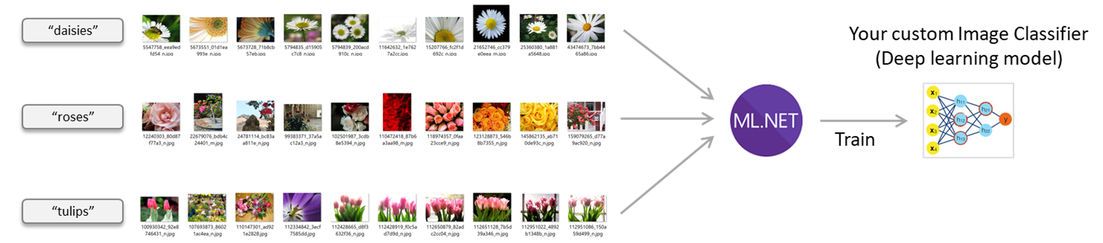
Support deep learning

Slide 10
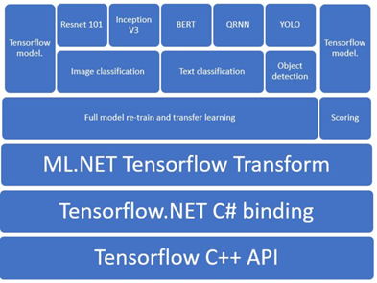
Tensorflow model compatible

Slide 11
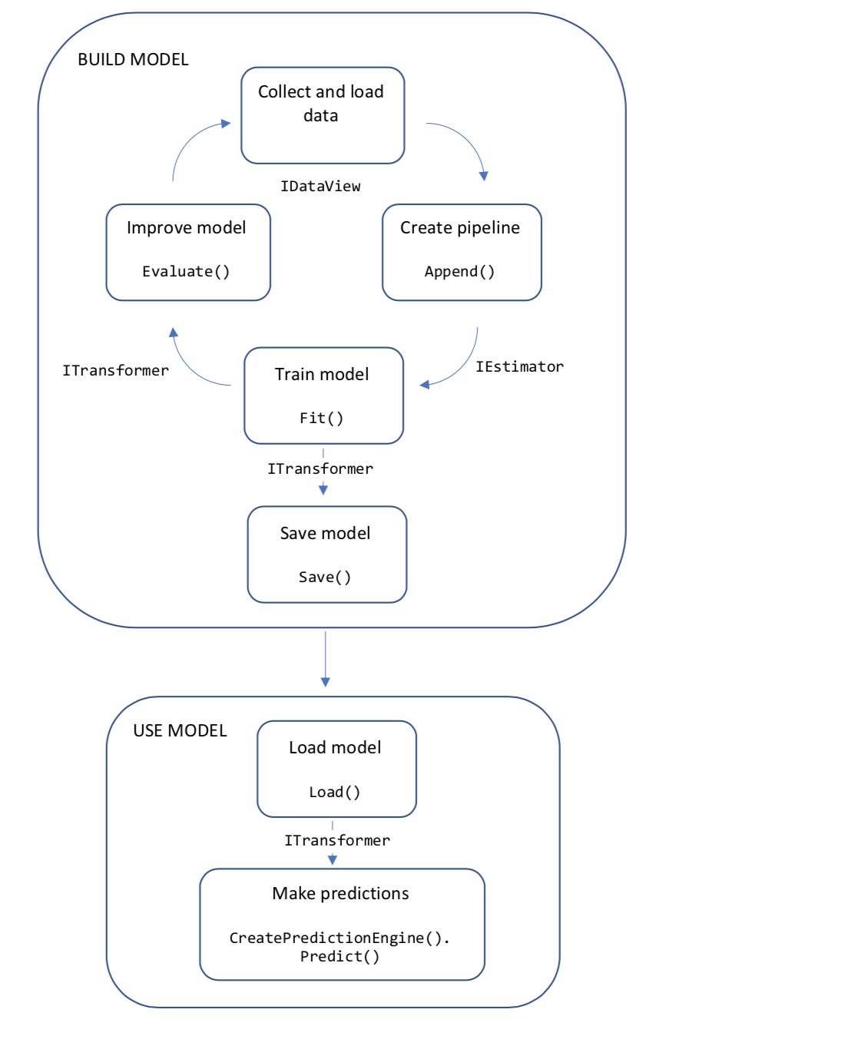
Machine learning workflow in ML.NET

Slide 12
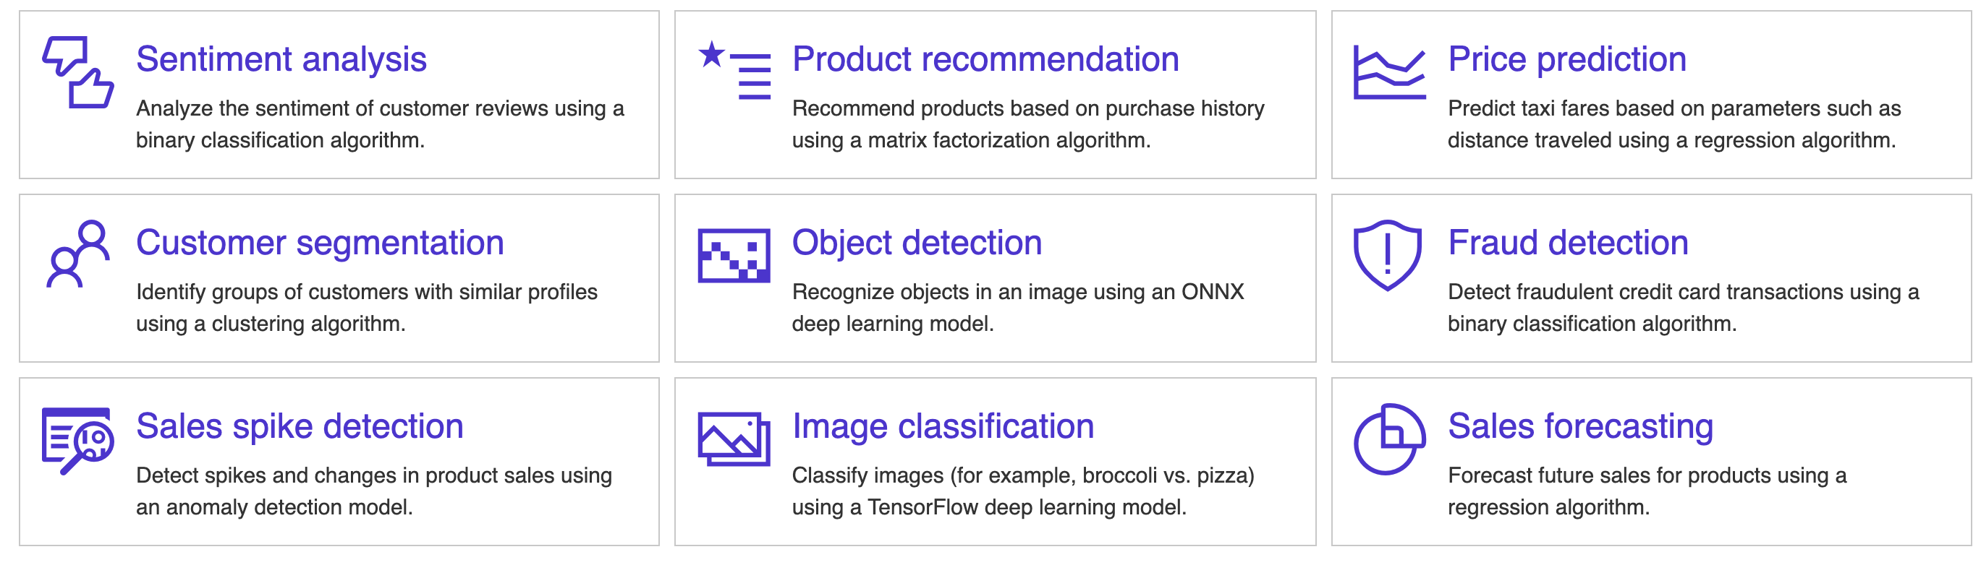
ML.NET scenarios

Slide 13
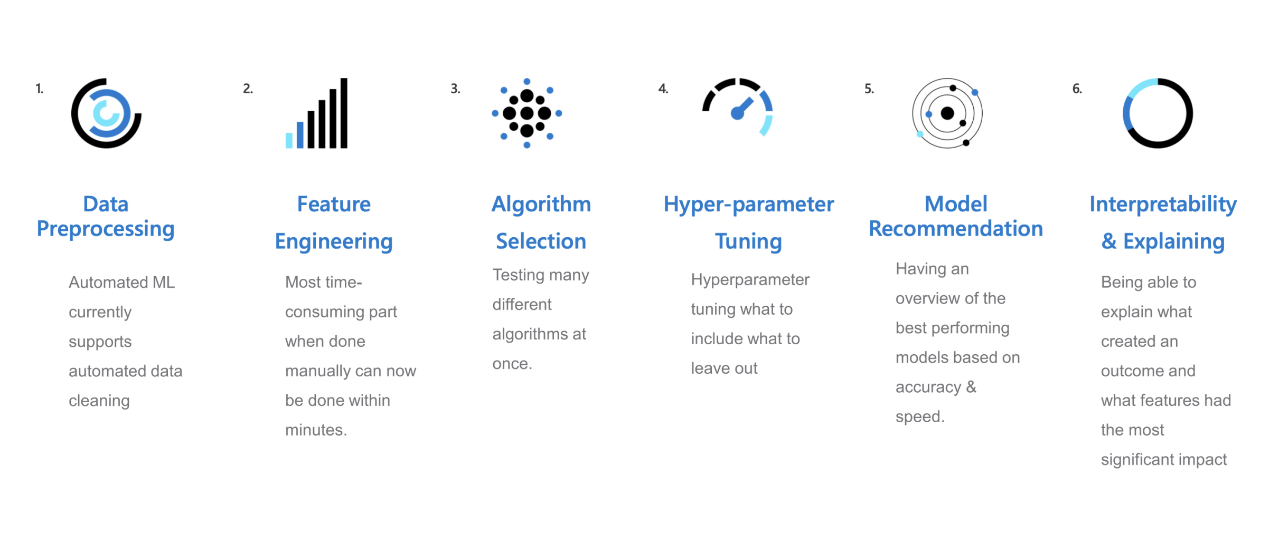
AutoML

Slide 14
Demo time

Slide 15

References
https://www.theurlist.com/letslearndotnet-ml
https://dotnet.microsoft.com/learn/ml-dotnet
https://docs.microsoft.com/en-us/learn/modules/predictive-maintenance-model-builder/
https://docs.microsoft.com/en-us/dotnet/machine-learning/how-to-guides/machine-learning-model-predictions-ml-net
https://docs.microsoft.com/en-us/dotnet/machine-learning/how-to-guides/train-machine-learning-model-ml-net
https://docs.microsoft.com/en-us/dotnet/machine-learning/resources/improve-machine-learning-model-ml-net
https://microsoft.github.io/SandDance/app/

Slide 16


Thanks for joining !
https://www.facebook.com/devcafevn

